Slide 1
Causal inference with transfer entropy: An introduction for beginners
Roni Barak Ventura
Center for Urban Science and Progress
Department of Mechanical and Aerospace Engineering
New York University Tandon School of Engineering
Society for Epidemiologic Research Annual Meeting
Austin, Texas
06/18/2024

Slide 2
Agenda
Part 1: Foundations of transfer entropy
Part 2: Demonstration
Part 3: Testing for statistical significance
Part 4: Extensions of transfer entropy
Part 5: Limitations0 minutes)

Slide 3



Causal Inference
Humans have been interested in causal relationships since the dawn of times
Although intuitive, it is challenging to translate causality into a mathematical equation
[National Geographic Creative; Tom Wang/Alamy]

Slide 4
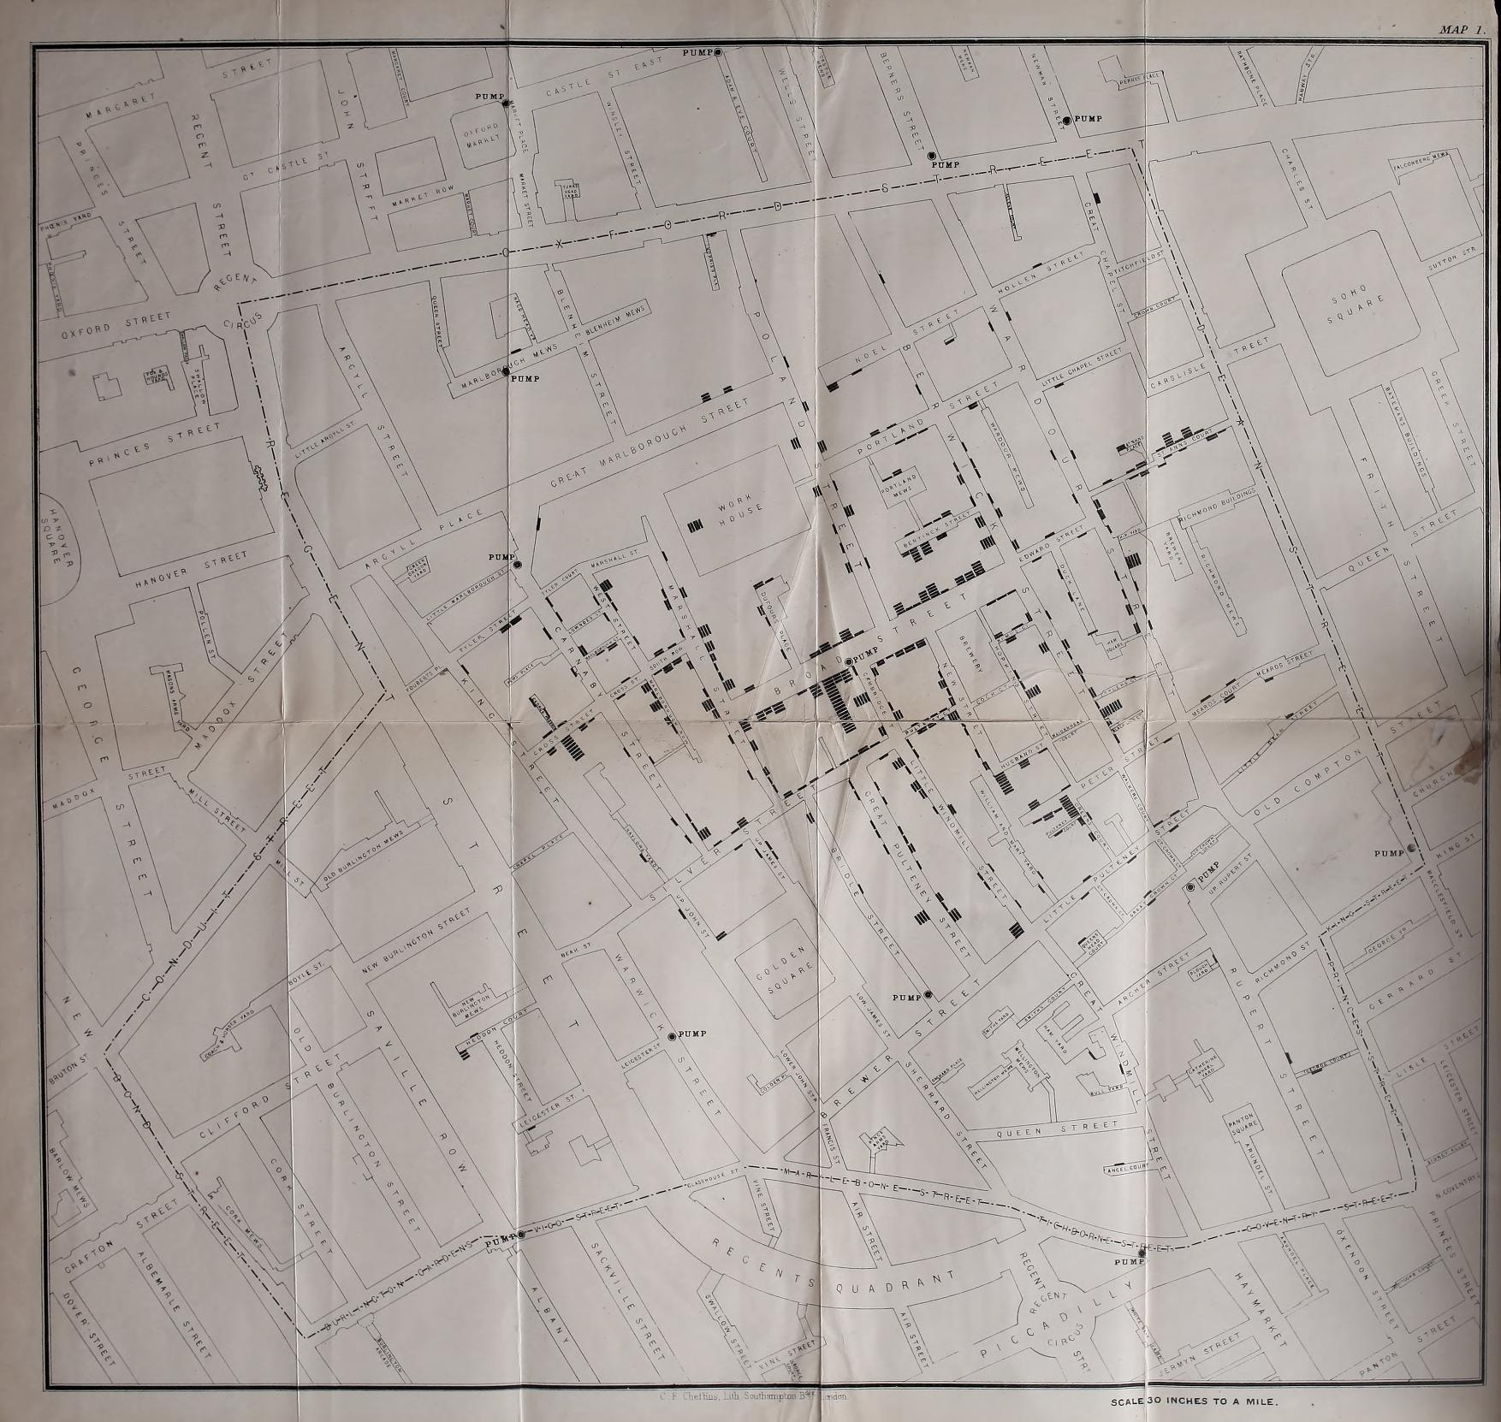
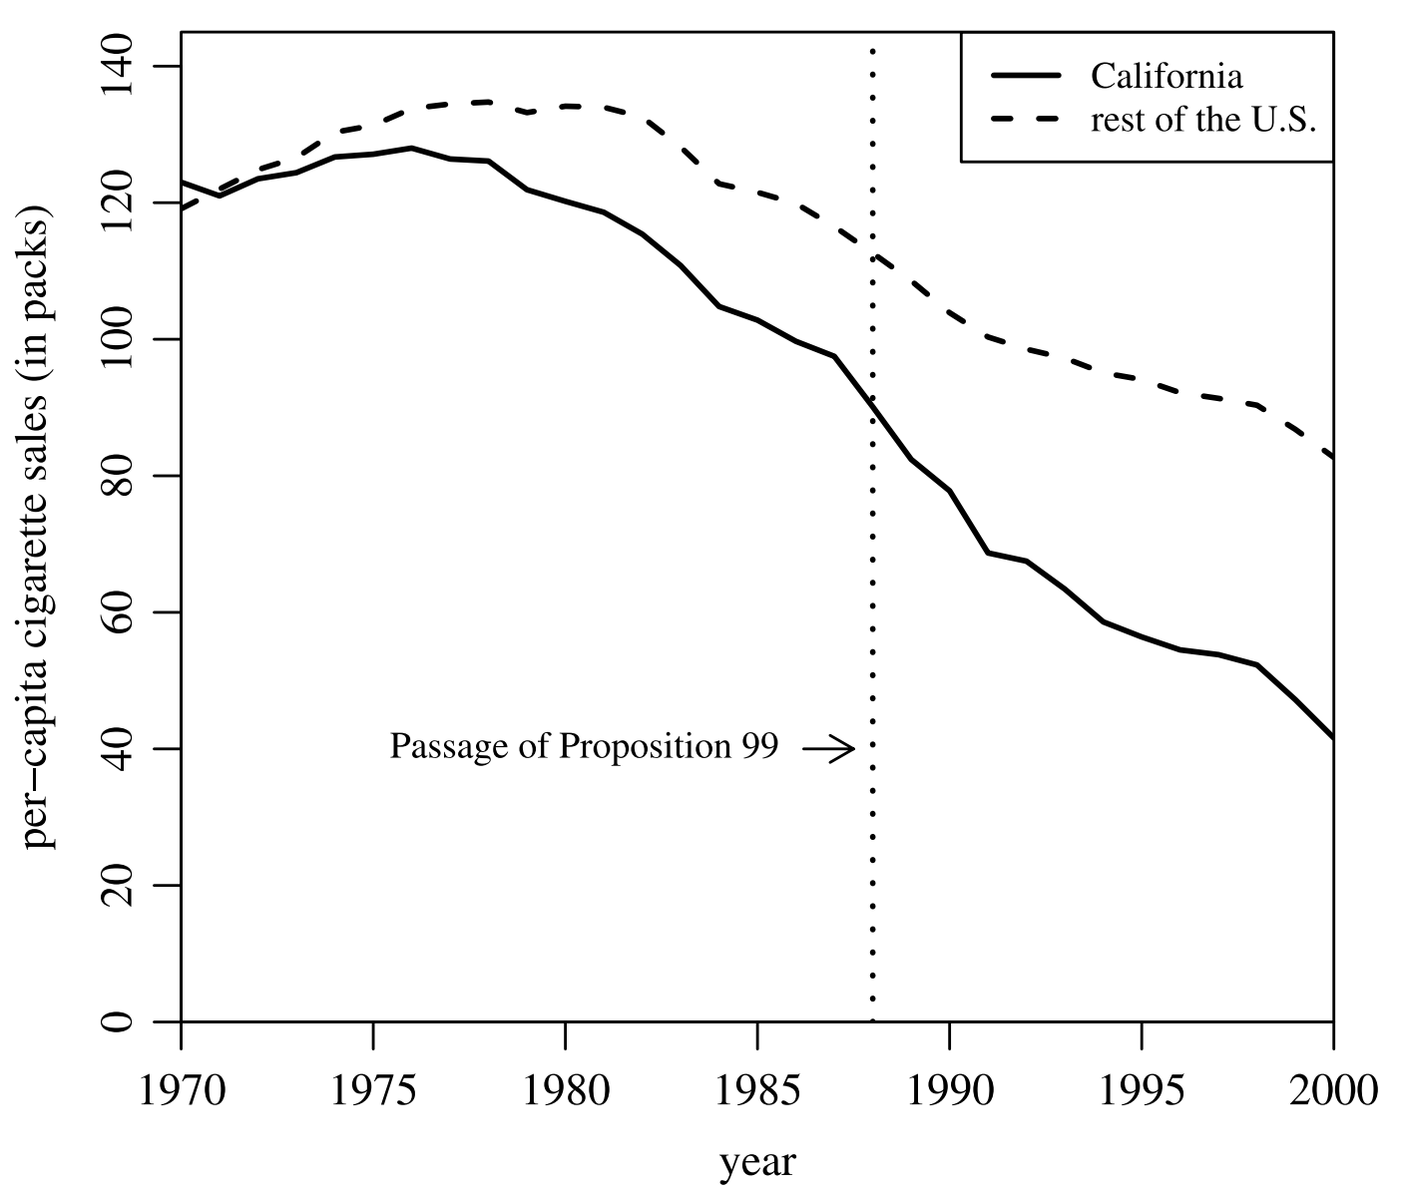
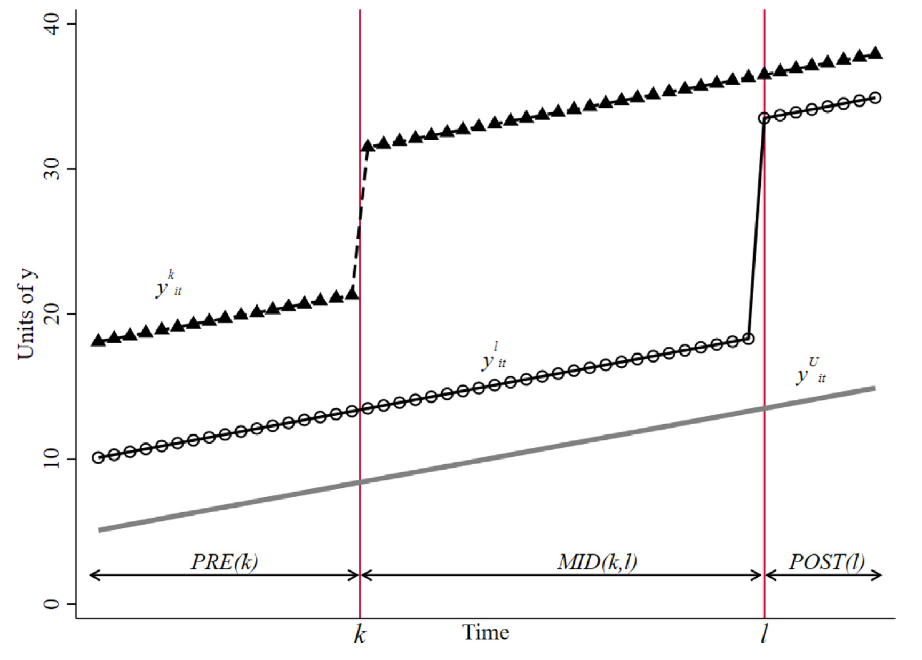
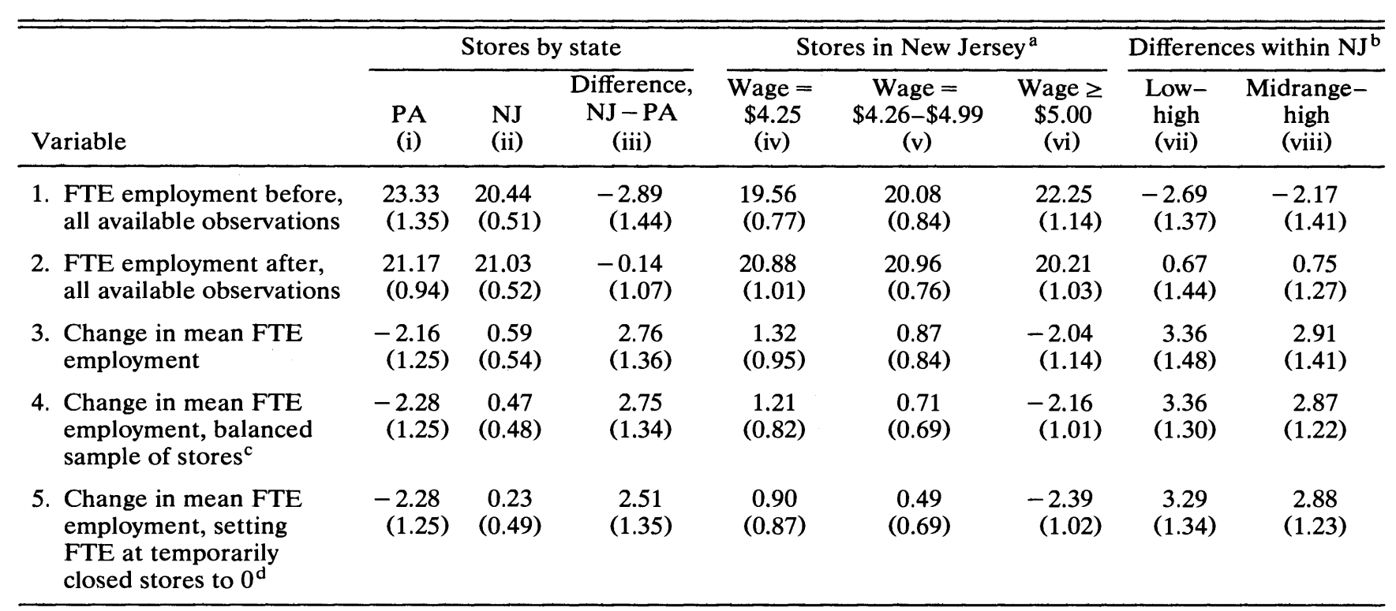
Several frameworks exist for causal inference
Counterfactual-based methods are most commonly employed for inference in epidemiology
[Card and Krueger 1994]
[Snow 1849]
[Goodman-Bacon 2021]
[Abadie et al. 2010]

Slide 5
Counterfactual-based analysis is not always feasible
Untreated units need to be identified or designed for an appropriate comparison
Treatment must be distinct over time
Treatments must be applied on units independently
Effects could be anecdotal and non-generalizable
Under certain conditions, alternative causal inference methods could enhance our understanding of treatments

Slide 6
Part 1: Foundations of transfer entropy

Slide 7
Granger Causality
Based on work by Wiener, Granger defined causality based on improved prediction
We say that X causes Y when X contains some information that improves the prediction of Y, and that information is not contained in the past of Y, nor in the past of ”all the information of the universe”
[Granger 1969; Wiener 1956; Runge 2018 ; Tom Wang/Alamy]
7

Slide 8
Assumptions of Granger Causality
Changes in X take place prior to the effect in Y
There is unique information in X about the future of Y
The time series sampling frequency corresponds to the amount of time Y takes to respond to changes in X
The time series of X and Y present variation throughout the period under consideration
The time series of X and Y are stationary
8

Slide 9
TRANSFER ENTROPY
Given two variables X and Y, transfer entropy quantifies the reduction in the uncertainty (entropy) of the prediction of the current state of X from its past due to additional knowledge about the past state of Y
X_{k-1}
X_{k}
X_{k+1}
Y_{k-1}
Y_{k}
Y_{k+1}
[Schreiber 2000]
k-1
k
k+1
9

Slide 10
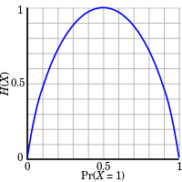

Information theory
A field in applied mathematics that was developed in the 1940s with the needs for communication and storage of information
A key concept in information theory is entropy, which quantifies the amount of uncertainty involved in a random process
[OB Production]
10

Slide 11
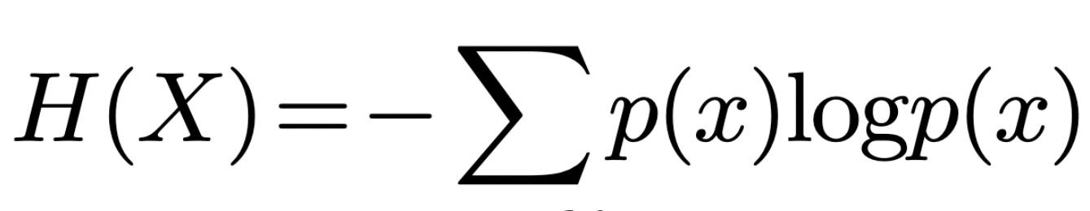
Breaking down transfer entropy, pt. I
Uncertain (high entropy)
Entropy represents the uncertainty with respect to the outcome of a variable
Assuming 𝑋 is a discrete variable, the entropy of 𝑋 is computed as
Where p(𝑥) is the probability that 𝑋 assumes the value 𝑥
More certain (low entropy)

Slide 12
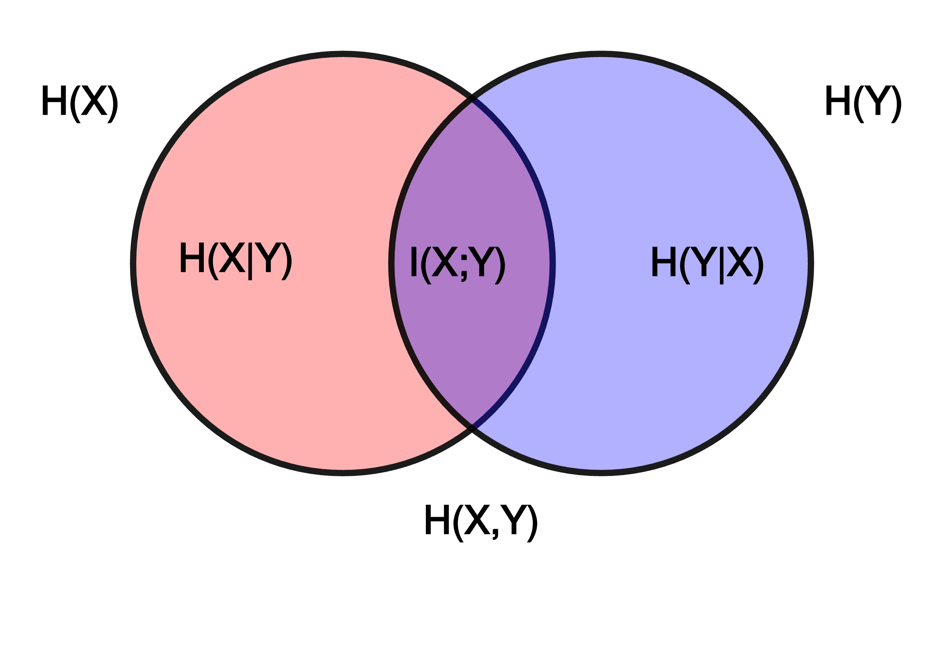
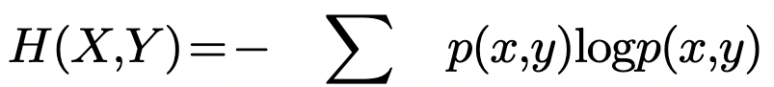
Breaking down transfer entropy, pt. II
Joint Entropy represents the uncertainty of a set of variables
Assuming 𝑋 and 𝑌 are discrete variables, their joint entropy is computed as
Where p(𝑥,y) is the probability that 𝑋 and 𝑌 assume the values 𝑥 and 𝑦, respectively

Slide 13
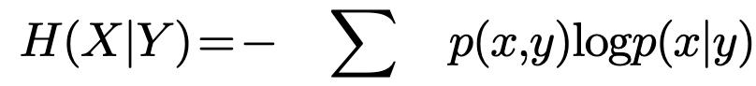
Breaking down transfer entropy, pt. III
Conditional Entropy measures the uncertainty of a variable, given the outcome of another variable
Assuming 𝑋 and 𝑌 are discrete variables, their conditional entropy is computed as
Where p(𝑥|y) is the probability that 𝑋 assumes the value 𝑥, given that 𝑌 assumes the value 𝑦

Slide 14
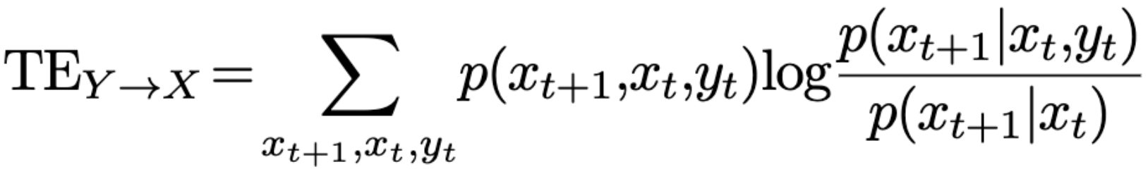
Breaking down transfer entropy, pt. IV
Transfer Entropy represents the reduction in uncertainty of the future of a variable, given knowledge about its present and the present of another variable
Transfer entropy from 𝑌 to 𝑋 is computed as

Slide 15
How do you compute transfer entropy between two time series?
Four general steps:
Sample the time series
Ensure there is no seasonality and trend in the time series
Compute probabilities of realizations
Compute transfer entropy value
15

Slide 16
1. Sample the time series
It is essential to determine an appropriate sampling rate that captures the cause-and-effect relationships
X
Y
time
High sampling rates can be treated with delay analysis, but are noisy and require intensive computing
16

Slide 17
2. Ensure there is no seasonality and trend in the time series
The presence of seasonality and trends may lead to false inference of a relationship
X
Y
time
There are several methods to remove seasonality and trends from time series
17

Slide 18
3. Compute probabilities of realizations
For transfer entropy, the probabilities of three realizations need to be computed: 𝑥_{t+1}, 𝑥_{t}, and 𝑦_{t}
There are many ways to compute probabilities of realizations (which remains an open research area):
Kernel density estimation
Digamma and Kozachenko–Leonenko estimators
Plug-in (Max-Likelihood) estimation
Simplest and most straightforward method
[Bossomaier, Barnett, Harre, and Lizier – An Introduction to Transfer Entropy]
18

Slide 19
3. Compute probabilities of realizations
For plug-in estimation, continuous variables must be discretized
time
For a continuous variable, samples would rarely repeat one another leading to very low probability of each observation and very high entropy
[Bossomaier, Barnett, Harre, and Lizier – An Introduction to Transfer Entropy]
19

Slide 20
3. Compute probabilities of realizations
Instead, one could bin the time series
time
The bins can be fixed in size, or adaptive
The number of bins will depend on the length of the time series and desired accuracy of probability density functions
[Bossomaier, Barnett, Harre, and Lizier – An Introduction to Transfer Entropy]
20

Slide 21
3. Compute probabilities of realizations
Alternatively, one could symbolize the dynamics of a time series
time
Trade-off:
More symbols would better capture the dynamics of a time series
More symbols would compromise the estimation of probability mass functions
[Bossomaier, Barnett, Harre, and Lizier – An Introduction to Transfer Entropy]
21

Slide 22
4. Compute transfer entropy value
Simply plugging-into the equation:
or
22

Slide 23
Part 2: Demonstration

Slide 24
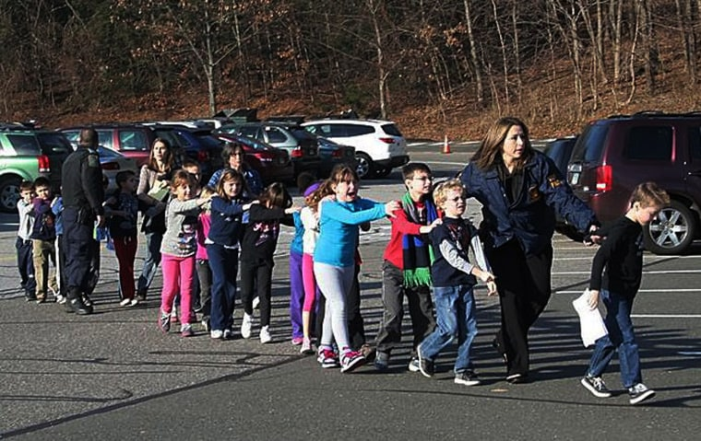

Why Americans buy guns?
Two main competing hypotheses
People buy guns for self-protection because they worry for their safety
People buy guns because they worry future legislation will prevent them from doing so
[Porfiri et al. 2019; Shannon Hicks; Savannah Morning News]
24

Slide 25

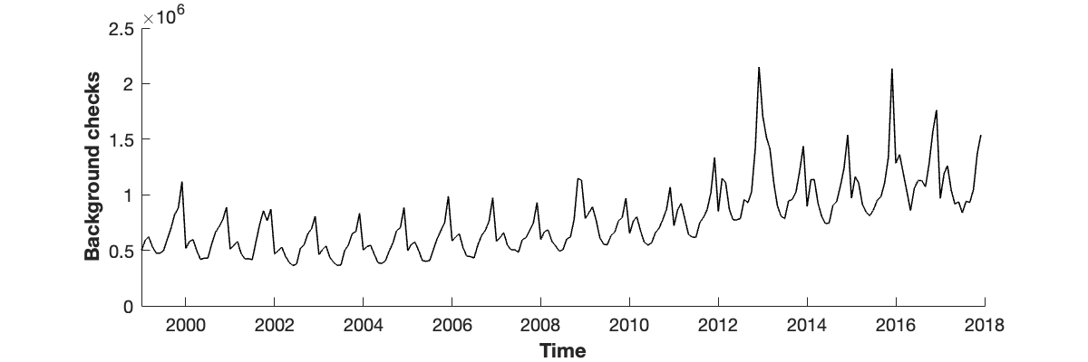
Data I
President Obama signs
23 executive actions for
gun control
Background checks
Monthly numbers of background checks in each state were obtained from the FBI’s National Instant Criminal Background Check System
[Porfiri et al. 2019]

Slide 26

Data II
Mass shootings
Monthly numbers of mass shooting events (defined as a shooting that took place in a public space, where at least four people excluding the shooter died) were obtained from the Mother Jones
[Porfiri et al. 2019]

Slide 27

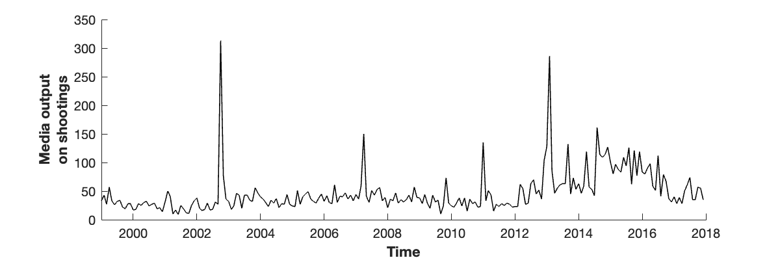
Data III
Sandy Hook
DC Sniper Attacks
Virginia Tech
Media output on shootings
Monthly numbers of articles about shootings were collected from ProQuest
[Porfiri et al. 2019]

Slide 28
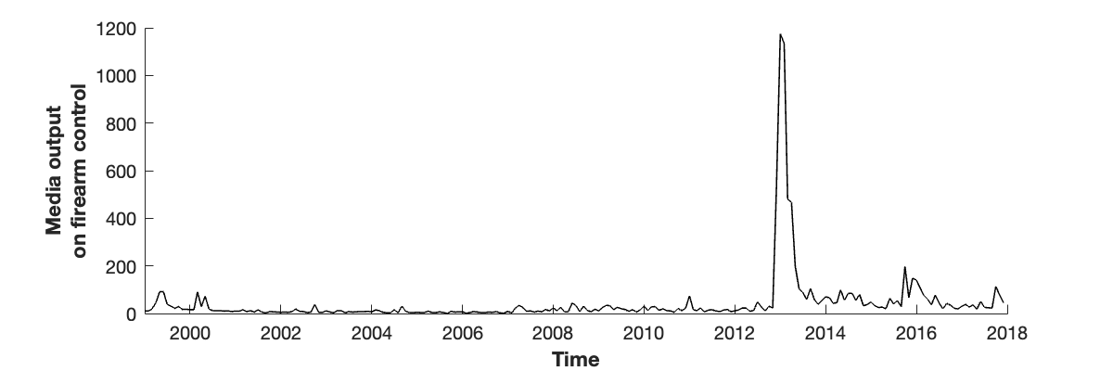
Data IV
Sandy Hook
Media output on firearm control
Monthly numbers of articles about firearm control (excluding those about shootings) were collected from ProQuest
[Porfiri et al. 2019]

Slide 29
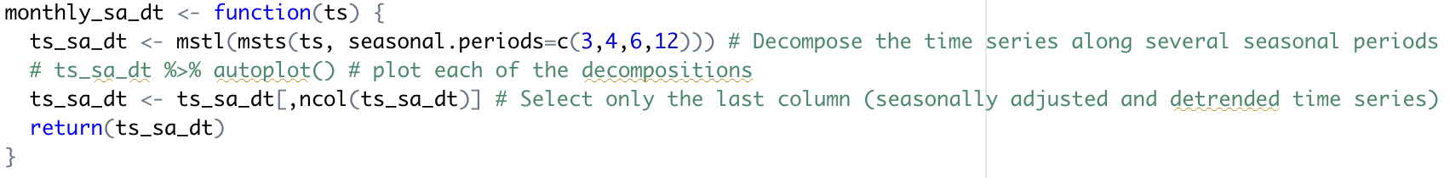
Seasonally-adjusting and detrending the time series
In R, one could use the “forecast” package to remove seasons and trends from time series
Seasonal adjustment and detrending is performed on the time series of background checks, media output on shootings, and media output on firearm control

Slide 30
Seasonally-adjusting and detrending the time series

Slide 31

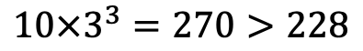
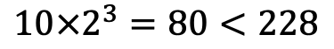
Symbolizing the time series
The time series contains 228 observations
Given three realizations to be estimated (𝑥_{t+1}, 𝑥_{t}, and 𝑦_{t}) and N symbols, there will be N³ possible joint probabilities to compute
In order to reliably estimate each joint probability, we want at least 10 × N³ observations
$$10×2^{3}=80<228$$
$$10×3^{3}=270>228$$
[Porfiri et al. 2019; Porfiri and Ruiz Marin 2020]

Slide 32
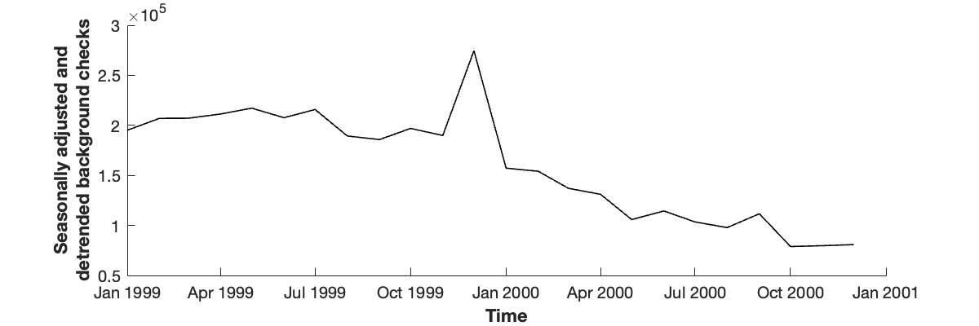
Symbolizing the time series
Example: we hypothesize that an increase in one variable (e.g., media coverage of firearm regulations) will lead to an increase in another variable (e.g., background checks)
An increase between two consecutive timesteps is symbolized with 1
A decrease (or no change) between two consecutive timesteps is symbolized with 0
[ 1 1 1 1 0 1 0 0 1 0 1 0 0 0 0 0 1 0 0 1 0 1 ]
[Porfiri et al. 2019; Porfiri and Ruiz Marin 2020]

Slide 33
Symbolizing the time series
We use the symbolized time series moving forward

Slide 34
Compute transfer entropy
For beginners, it may be more intuitive to write a code using the probability-based equation of transfer entropy:
However, this method is computationally inefficient and time-consuming

Slide 35
Compute transfer entropy
The entropy-based equation can be used to compute transfer entropy:
Computing conditional entropies in code could become cumbersome
To ease the computation of entropies, the equation can be rewritten as:
Next, a code that computes joint entropy can be formulated

Slide 36
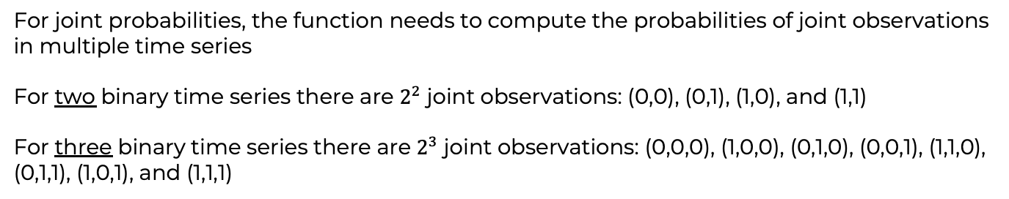
Compute entropy
Recall:
The function needs to compute the probabilities of observations (0s and 1s) in a time series
Also recall:
For joint probabilities, the function needs to compute the probabilities of joint observations in multiple time series
For two binary time series there are $2^{2}$ joint observations: (0,0), (0,1), (1,0), and (1,1)
For three binary time series there are $2^{3}$ joint observations: (0,0,0), (1,0,0), (0,1,0), (0,0,1), (1,1,0), (0,1,1), (1,0,1), and (1,1,1)

Slide 37
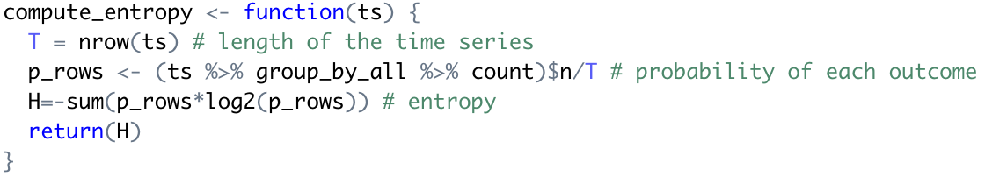
Compute entropy
The function takes a data frame as input, where each column is a time series. It does the following:
Obtain the length of the time series
Count the number of times each unique row appears (each would represent a possible outcome)
Divide the counts by the length of the time series to get a probability of each outcome
Compute the (joint) entropy

Slide 38
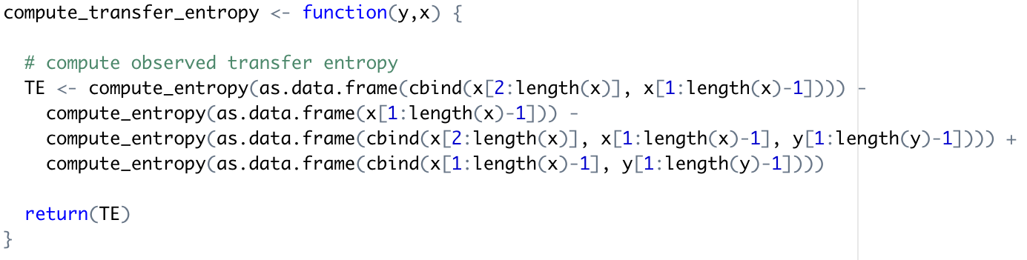
Compute transfer entropy
Returning to the transfer entropy equation:
We apply the entropy function we developed:

Slide 39
Compute transfer entropy
TE = 0.011 bits
TE < 0.001 bits
TE = 0.014 bits

Slide 40
Part 3: Testing for statistical significance

Slide 41
We have some results
Transfer entropy from media output on firearm regulations to background checks
0.011 bits
Transfer entropy from media output on shootings to background checks
<0.001 bits
Transfer entropy from mass shootings to background checks
0.014 bits
Are these values statistically different from zero?

Slide 42
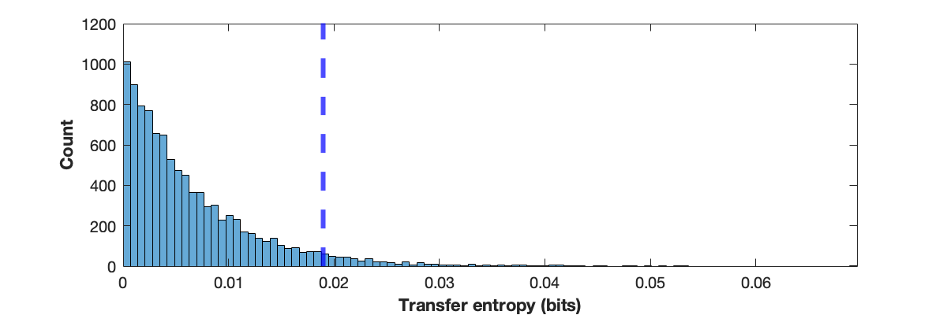
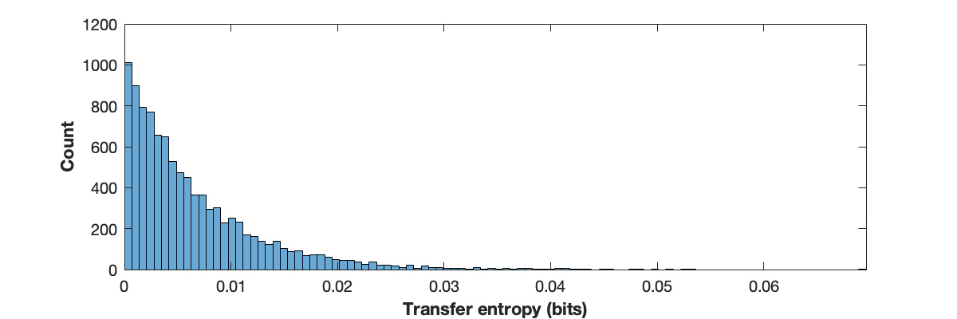

Permutation tests
To determine whether observed transfer entropy is significantly different from zero, we will compare it against the amount of transfer entropy that would be measured between two uninteracting time series
Shuffle the time series of Y (the source variable)
Compute transfer entropy
Repeat steps 1 and 2 thousands of times to generate a surrogate distribution
Compute the distribution’s right-tail value
Test whether the measured transfer entropy is greater than the distribution’s right-tail value

Slide 43
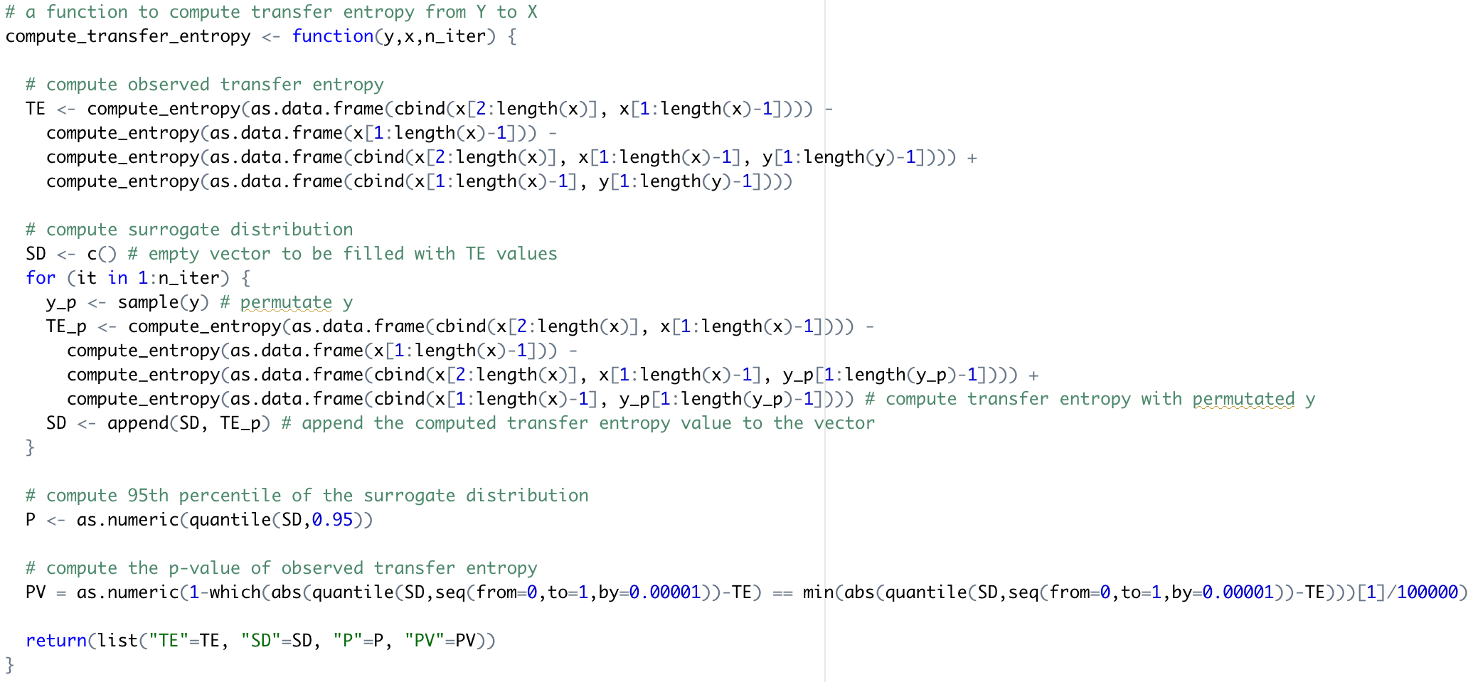
Permutation tests
The code to compute transfer entropy can be enhanced with a permutation test:
This portion of the code remains the same
We append the computed transfer entropy to the surrogate distribution vector
We create an empty vector which will be filled with values of transfer entropy
We compute transfer entropy n_iter times
We permutate the source variable y
We compute transfer entropy with permutated y
We compute the p-value of the observed transfer entropy relative to the surrogate distribution
We return the observed transfer entropy, surrogate distribution, 95th percentile, and p-value
We compute the 95th percentile of the surrogate distribution

Slide 44
Permutation tests
Transfer entropy from media output on firearm regulations to background checks
0.011 bits
Transfer entropy from media output on shootings to background checks
<0.001 bits
Transfer entropy from mass shootings to background checks
0.014 bits
None of the hypotheses are supported by these findings

Slide 45
Part 4: Extensions of transfer entropy

Slide 46
Extensions of transfer entropy
There are many possible extensions to transfer entropy, addressing different scenarios:
Conditional transfer entropy
Source–target lag
Partial transfer entropy
Local transfer entropy
Momentary transfer entropy
And more!
[Bossomaier et al. 2016; Wibral et al. 2013; Papana et al. 2020; Pompe and Runge 2011]

Slide 47
Conditional transfer entropy
Similarly to how confounding variables are accounted to in Directed Acyclic Graphs by conditioning on them, one could account for confounding variables in transfer entropy through conditioning
Beginning with the transfer entropy equation:
A third variable Z that may be a confounder can be added as follows:
[Bossomaier et al. 2016]

Slide 48
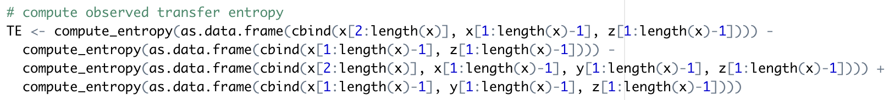
Conditional transfer entropy
For simpler coding, we simplify the equation to include only joint entropies:
In code, this equation is computed as:
While computing the observed value of transfer entropy is simple, determining whether it is different from zero is trickier
[Bossomaier et al. 2016]

Slide 49
Conditional transfer entropy
When performing a permutation test, it is important to preserve the association between X_{t} and Z_{t}.
Therefore, permutations are carried out as follows:
Subset the four time series based on a unique outcome of (X_{t}, Z_{t}); e.g., subset all instances where X_{t} =0 and Z_{t} =1
Shuffle Y_{t} only while maintaining the rest of the time series
Repeat for all possible outcomes of (X_{t}, Z_{t})
[Runge 2018]

Slide 50
Conditional transfer entropy
Consider the following toy example:
X_{t} | X_{t+1} | Y_{t} | Z_{t}
1 | 1 | 1 | 0
1 | 0 | 1 | 0
0 | 0 | 1 | 1
0 | 1 | 1 | 0
1 | 0 | 0 | 1
0 | 1 | 1 | 1
1 | 0 | 0 | 0
0 | 0 | 1 | 0
0 | 0 | 0 | 0
X_{t} | X_{t+1} | Y_{t} | Z_{t}
1 | 1 | 0 | 0
1 | 0 | 1 | 0
0 | 0 |  | 1
0 | 1 | 1 | 0
1 | 0 |  | 1
0 | 1 |  | 1
1 | 0 | 1 | 0
0 | 0 | 0 | 0
0 | 0 | 1 | 0
X_{t} | X_{t+1} | Y_{t} | Z_{t}
1 | 1 |  | 0
1 | 0 |  | 0
0 | 0 |  | 1
0 | 1 |  | 0
1 | 0 |  | 1
0 | 1 |  | 1
1 | 0 |  | 0
0 | 0 |  | 0
0 | 0 |  | 0
X_{t} | X_{t+1} | Y_{t} | Z_{t}
1 | 1 |  | 0
1 | 0 |  | 0
0 | 0 |  | 1
0 | 1 | 1 | 0
1 | 0 |  | 1
0 | 1 |  | 1
1 | 0 |  | 0
0 | 0 | 0 | 0
0 | 0 | 1 | 0
X_{t} | X_{t+1} | Y_{t} | Z_{t}
1 | 1 | 0 | 0
1 | 0 | 1 | 0
0 | 0 | 1 | 1
0 | 1 | 1 | 0
1 | 0 |  | 1
0 | 1 | 1 | 1
1 | 0 | 1 | 0
0 | 0 | 0 | 0
0 | 0 | 1 | 0
X_{t} | X_{t+1} | Y_{t} | Z_{t}
1 | 1 | 0 | 0
1 | 0 | 1 | 0
0 | 0 | 1 | 1
0 | 1 | 1 | 0
1 | 0 | 0 | 1
0 | 1 | 1 | 1
1 | 0 | 1 | 0
0 | 0 | 0 | 0
0 | 0 | 1 | 0
Permutation

Slide 51
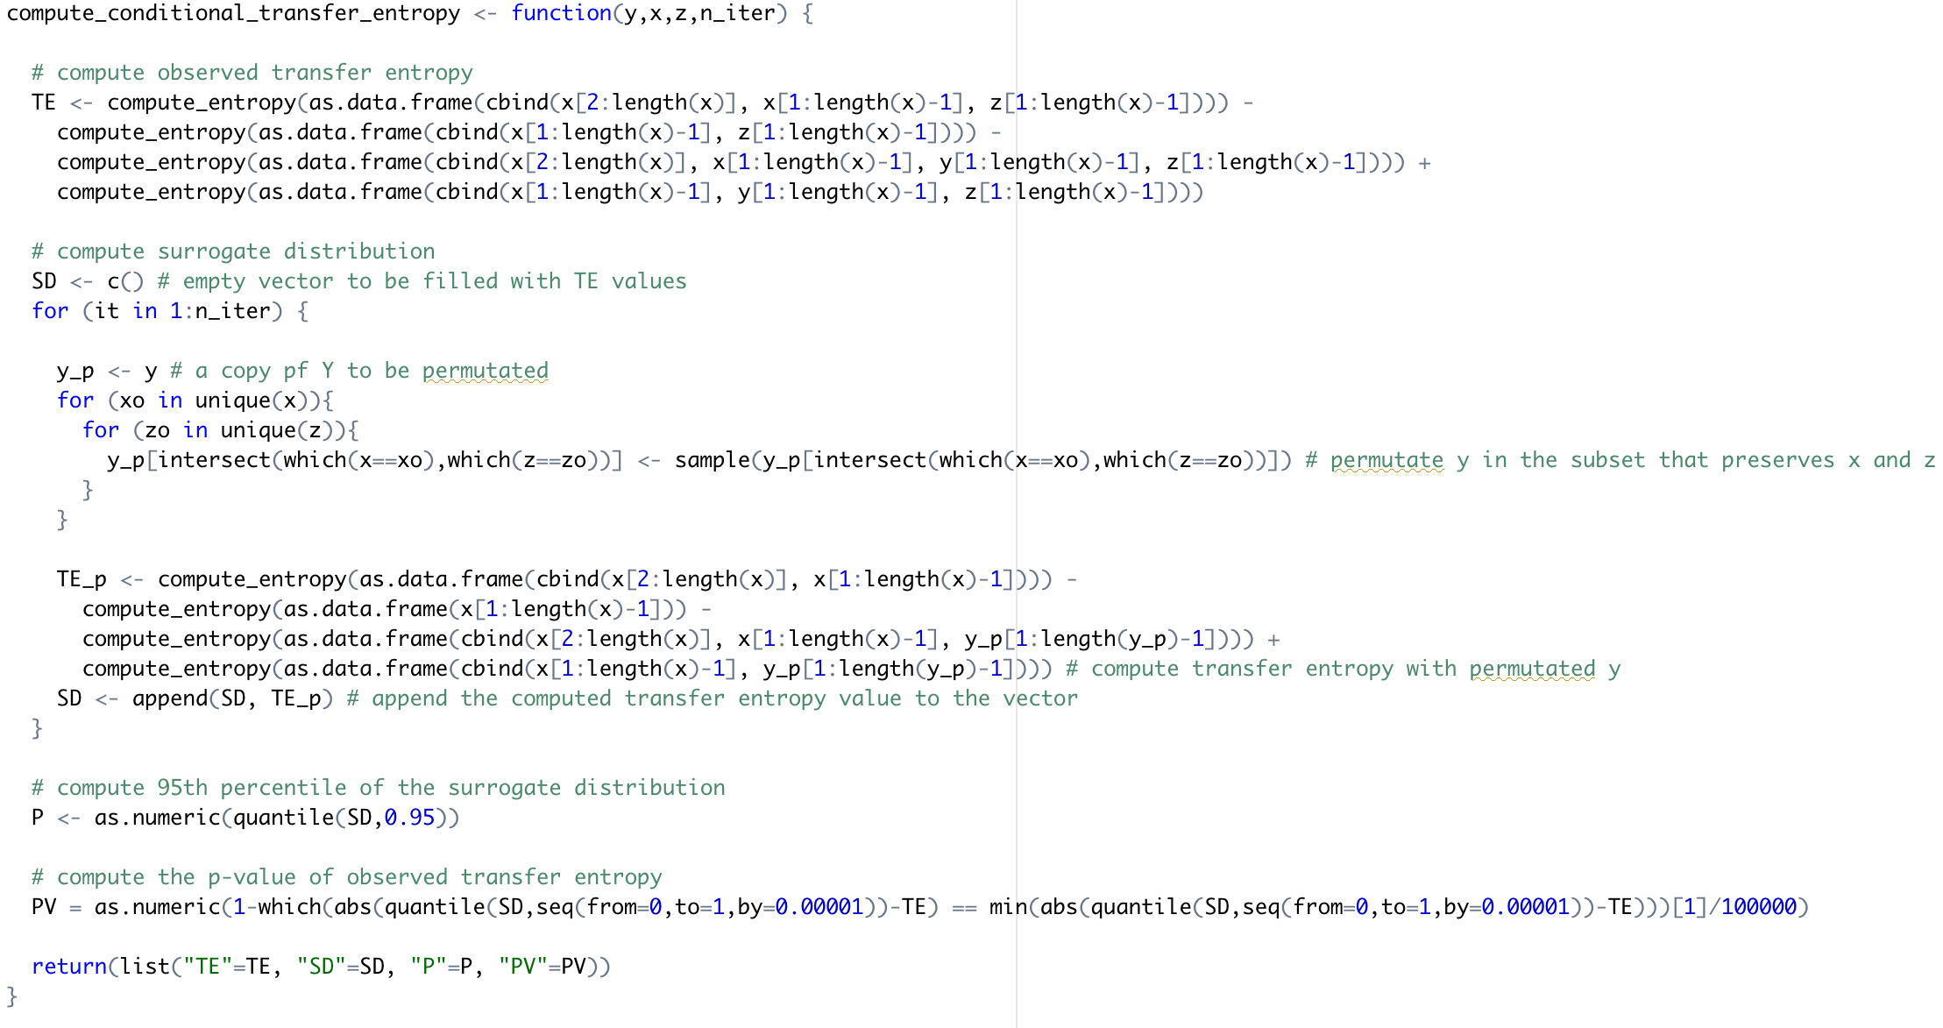
Conditional transfer entropy
The function now includes input z
Transfer entropy is computed as before
We create an empty vector and perform permutation n_iter times as before
A clean copy of the source time series is created
We iterate through possible outcomes of x and z pairs
We shuffle the copy of the source with respect to fixed x and z pairs
We compute transfer entropy with the permutated y
We compute the statistics as before

Slide 52
Conditional transfer entropy
Transfer entropy from media output on firearm regulations to background checks
0.011 bits
Transfer entropy from media output on shootings to background checks
<0.001 bits
Transfer entropy from mass shootings to background checks
0.014 bits
Transfer entropy from media output on firearm regulations to background checks, conditioned on mass shootings
0.038 bits
Transfer entropy from media output on shootings to background checks, conditioned on mass shootings
0.023 bits
Transfer entropy from mass shootings to background checks, conditioned on media output on shootings
0.037 bits

Slide 53
Conditional transfer entropy
Accounting for confounding variables is done through conditional transfer entropy
One could account for multiple confounding variables by extending the conditional transfer entropy as follows:
To ensure accurate estimation of probability density functions and high power of statistical tests, the number of confounding variables that can be integrated for will be limited
Performing statistical tests for conditional transfer entropy must preserve the associations between the target variable X and the variables conditioned upon

Slide 54
Source-target lag
In the traditional transfer entropy framework, we assume a process where the target variable X is influenced by the source variable Y a single time step later
It is possible that a lag exists between the source variable Y and the target variable X (the interaction takes effect longer than a single time step):
The time series may have been unintentionally oversampled
A higher sampling rate may be desirable because an interaction could be initiated while an interaction is still ongoing; more samples could improve the statistical power of an analysis
Analyses of different time scales may reveal different dynamics
Notes:
Examples: IEEE TG and daily vs. monthly analyses

Slide 55
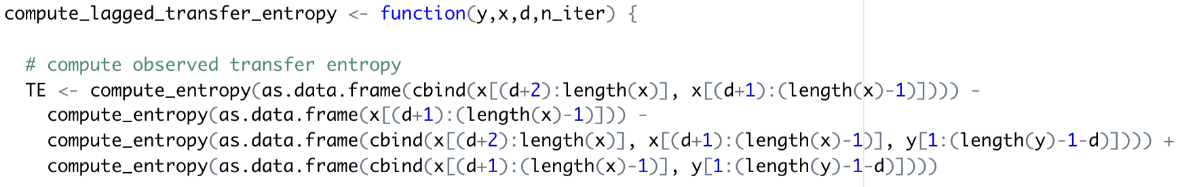
Source-target lag
To introduce a lag into transfer entropy, one would shift the time series of the source variable Y relative to the time series of the target variable X:
The function now takes input d with the delay to be considered
In code, this is achieved by truncating time series with the delay:
The time series of X_{t+1} starts from the (d+2)th time step and ends at the last time step
The time series of Y_{t-ẟ} starts from the first time step and ends (d+1) time steps before its end
The time series of X_{t} starts from the (d+1)th step (d steps after Y_{t}) and ends one time step before its end

Slide 56
Source-target lag
If transfer entropy is computed for multiple lags, one can explore which one maximizes the association:
Transfer entropy from media output on firearm regulation to background checks

Slide 57
Source-target lag
The transfer entropy framework is flexible enough to consider lags in interactions between variables.
Depending on the system under consideration, one could evaluate:
Lags between X_{t} and X_{t+1}
Lags between X_{t} and Z_{t}
Lags between Y_{t} and Z_{t}
Lags between X_{t}, Y_{t}, and Z_{t}
Any other combination!
There exist algorithms for causal discovery such as PCMCI that explore those different lags
Notes:
Examples: IEEE TG and daily vs. monthly analyses

Slide 58
Part 5: Limitations

Slide 59
Transfer entropy has many limitations
The robustness and versatility of transfer entropy depends on the length and variability of time series
Transfer entropy cannot orient contemporaneous effects
Transfer entropy cannot account for latent variables
Transfer entropy does not measure a truly causal interaction, but a temporal association
Other methods exist that can complement transfer entropy to identify causal interactions:
Peter-Clark (PC) algorithm
Convergent cross mapping
Counterfactual-based causal inference

Slide 60
Conclusions

Slide 61
Conclusions
Transfer entropy is a method to understand (causal) associations between variables from their time series
The application of transfer entropy requires time series that are rich with information and do not contain seasonal effects or trends
Time series can be symbolized to better capture the dynamics between variables
Estimation of probability density functions can be achieved in numerous ways: plug-in estimation is the most intuitive method but it comes at the cost of many observations
Conditional transfer entropy could account for confounding variables, although it requires longer time series
Lagged interactions can be incorporated into transfer entropy analysis to understand how dynamics change with time scales
Transfer entropy analysis has a few limitations
It is debatable whether transfer entropy unveils truly causal relationships, however, it can be complemented by alternative methods to establish causality

Slide 62





Thank you for your attention! Questions?

